Slide 1

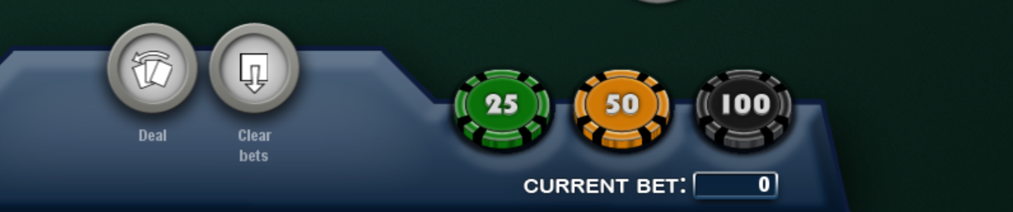

Dealer Cards
Royal Flush | 100 to 1
Straight Flush | 50 to 1
4 of a kind | 30 to 1
Full House | 8 to 1
Flush | 7 to 1
Straight | 4 to 1
Trips | 3 to 1
Bonus
Community Cards
ANTE
=
BLIND
Royal Flush | 200 to 1
Straight Flush | 50 to 1
4 of a kind | 10 to 1
Full House | 3 to 1
Flush | 3 to 2
Straight | 1 to 1
All Other | Push
PLAY
Player Cards
PLAY
7X Ante with POCKET ACES
3X or 4X Ante after Hole Cards
2X Ante after Flop
1X Ante or Fold after Final 2 Cards

Slide 2


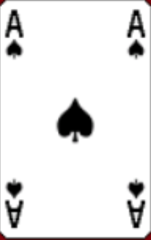
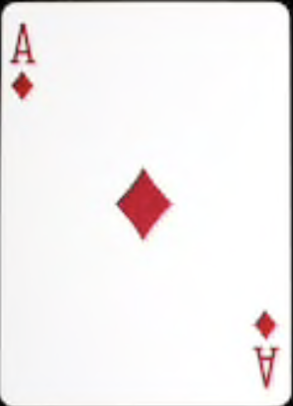
Dealer Cards
Royal Flush | 100 to 1
Straight Flush | 50 to 1
4 of a kind | 30 to 1
Full House | 8 to 1
Flush | 7 to 1
Straight | 4 to 1
Trips | 3 to 1
Bonus
Community Cards
ANTE
=
BLIND
Royal Flush | 200 to 1
Straight Flush | 50 to 1
4 of a kind | 10 to 1
Full House | 3 to 1
Flush | 3 to 2
Straight | 1 to 1
PLAY
Player Cards
PLAY
7X Ante with POCKET ACES
3X or 4X Ante after Hole Cards
2X Ante after Flop
1X Ante or Fold after Final 2 Cards

Slide 3
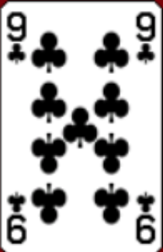
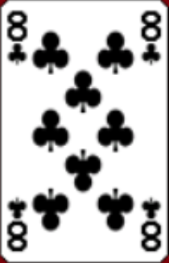
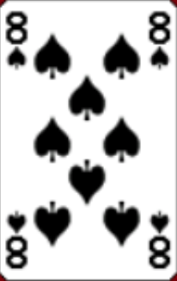
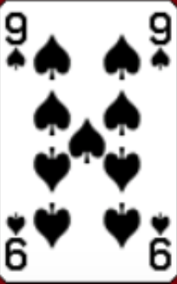

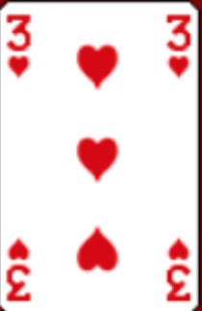
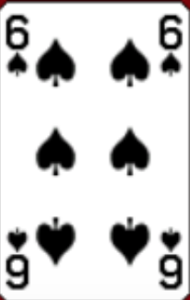
Dealer Cards
Royal Flush | 100 to 1
Straight Flush | 50 to 1
4 of a kind | 30 to 1
Full House | 8 to 1
Flush | 7 to 1
Straight | 4 to 1
Trips | 3 to 1
Bonus
Community Cards
ANTE
=
BLIND
Royal Flush | 200 to 1
Straight Flush | 50 to 1
4 of a kind | 10 to 1
Full House | 3 to 1
Flush | 3 to 2
Straight | 1 to 1
PLAY
Player Cards
PLAY
7X Ante with POCKET ACES
3X or 4X Ante after Hole Cards
2X Ante after Flop
1X Ante or Fold after Final 2 Cards

Slide 4
Overview
Texas Hold’em - Pocket Aces Editon is played with one standard 52-card deck
Player and dealer are dealt 2 cards face down
5 community cards are dealt
Player and Dealer use their 2 cards and the 5 community cards to make their best 5 card poker hand
Rules
Player must make a wager on the Ante and Blind (equal amount)
Optional wager on the Bonus which is based on the poker rank of the final hand
Players 2 cards are exposed
The player can make a Play wager of 3X or 4X the Ante (7X if they have Pocket Aces) or CHECK
The flop (3 community cards starting from the left) are exposed
If the player hasn’t made a Play wager, they can make a Play wager 2X the Ante or CHECK
The last 2 cards are exposed
The player can make a Play wager equal to the Ante or FOLD
The Player and Dealer hands are compared for the best 5 card Poker hand

Slide 5
Texas Hold’em
Pocket Aces
Edition

